Slide 1
Banka KSD
School project related to “b00le0”

Slide 2
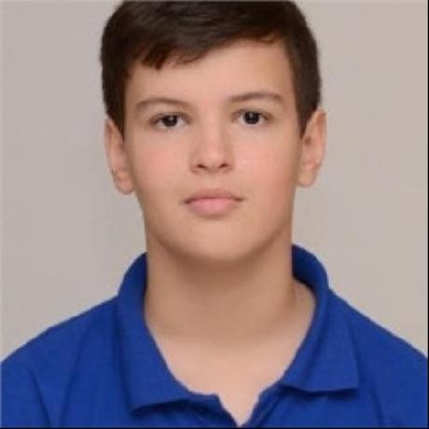
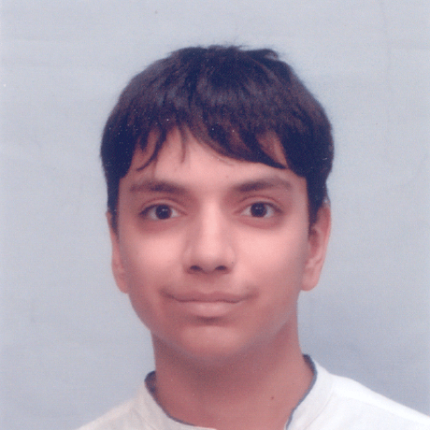
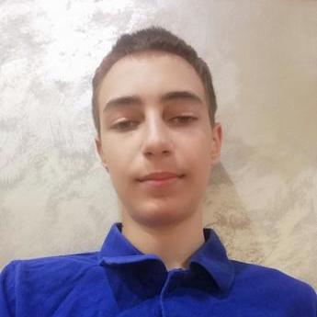
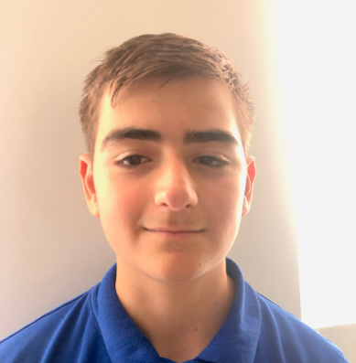
OUR TEAM
Scrum Trainer
Valeri Ivanov
Backend Developer
Alexander Manov
Galin Georgiev
Backend Developer
Maxim Marinov
QA Engineer

Slide 3
OUR THOUGHT PROCESS
# 2
Our Realization
# 1 Our Idea
# 4
Our Team
# 3
Used technologies & tools

Slide 4
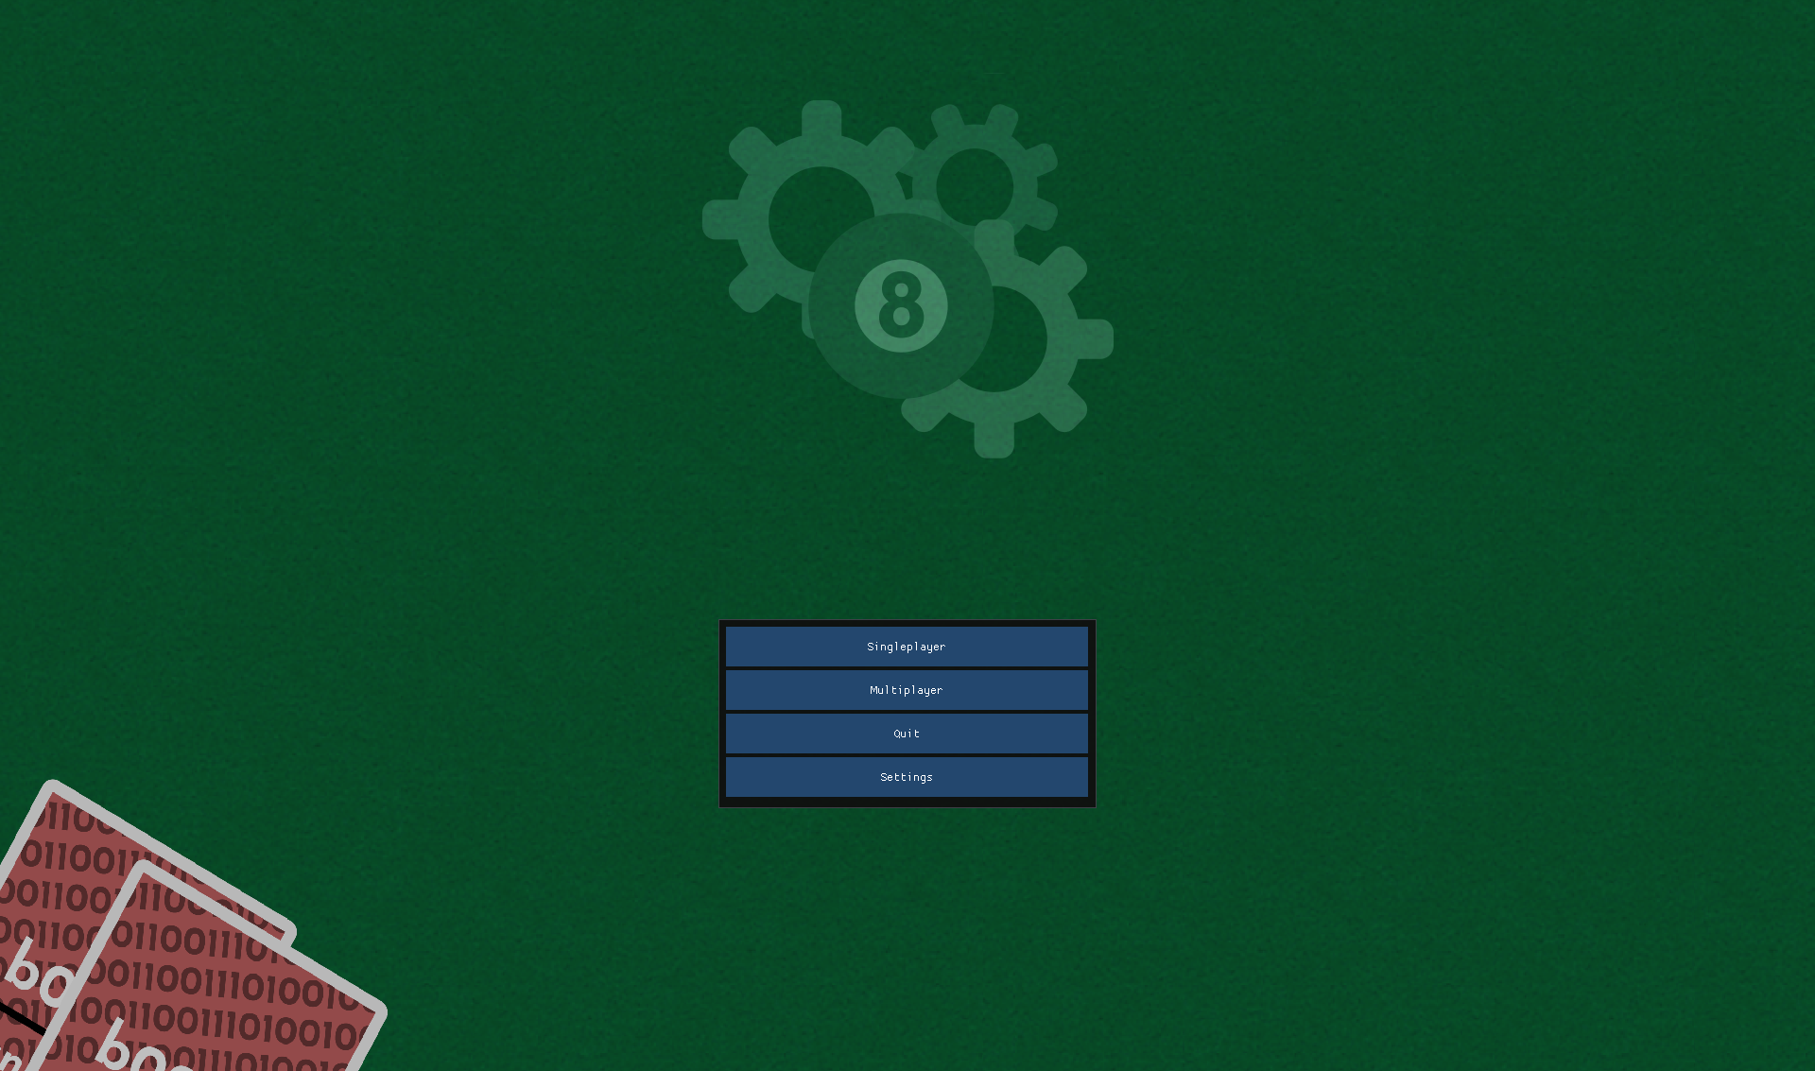
Idea
We had a total of 25 days to build up this project from the ground up with nothing but the ruleset and the initial design of the already implemented nand gate cards.

Slide 5
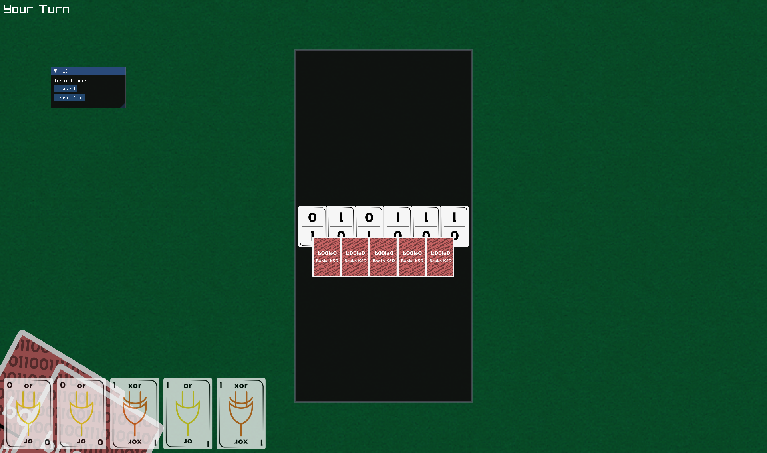
Realization
We realized our project through collaborative work across different online platforms and coding environments.
Every day we held meetings to discuss progress and responsibilities of the team members.

Slide 6














USED TECHNOLOGIES

Slide 7
NOW LET’S SEE THE APP!

